Slide 1
HMC System C Simulator
Yu Zou
Vinayak Deshpande
MS students
Dr. Herman Lam
Assoc. Professor of ECE
University of Florida

Slide 2
Agenda
CHREC overview
Notional CMC Architecture
Performance Measurement on Merlin Board
Mapping Notional CMC onto Merlin Board
Validation of Measurements
HMC Configuration
Collected Trace File – From Merlin Board
Generated Trace File – For Simulator
HMC SytemC Simulator - Architecture
HMC SytemC Simulator - Results

Slide 3



What is CHREC?
NSF Center for High-Performance Reconfigurable Computing
Unique US national research center, operational since January 2007
Leading ECE/CS research groups @ 3 (soon 4) major universities
University of Florida (lead)
Brigham Young University
Virginia Tech
Under auspices of I/UCRC Program at NSF
Industry/University Cooperative Research Center
CHREC is supported by CISE Directorate @ NSF
CHREC is both National Research Center and Consortium
University groups serve as research base (faculty, students, staff)
Industry & government organizations are research partners, sponsors, collaborators, advisory board, & technology-transfer recipients
Cited by NSF as one of its top national R&D centers
University of Pittsburgh (lead)
Brigham Young University
Virginia Tech
University of Florida
2017

Slide 4


CHREC Members
AFRL Sensors Directorate
AFRL Space Vehicles Directorate
Altera
BAE Systems
Boeing
Cisco Systems
Draper Laboratory
Emergent Space Tech
Fermilab
Gidel
Harris
Honeywell
IBM
Innoflight
Laboratory for Physical Sciences
Lockheed-Martin Space Systems
Los Alamos National Laboratory
MIT Lincoln Laboratory
NASA Ames Research Center
NASA Goddard Space Flight Center
NASA Johnson Space Center
NASA Kennedy Space Center
National Instruments
National Security Agency
Office of Naval Research
Raytheon
Rockwell Collins
Sandia National Laboratories
Space Micro
SSE/PlanetiQ
Walt Disney Animation Studios
Xilinx

Slide 5
Notional CMC* Architecture
Based on Nair et al.** : an HMC with a user-programmable logic layer
A, B, C, D, and : performance-measurement points of interest
* CMC: Custom Memory Cube
** Nair, R., et al. "Active Memory Cube: A processing-in-memory architecture for exascale systems.“ IBM Journal of Res. & Development 59.2/3 (2015): 17-1.

Slide 6
Performance Measurement on Merlin Board
CMC platform on Merlin board
*
Instrumented Merlin infrastructure with hardware performance monitors
A’, B’, C’, D’, M1, M2, M3, M4, M5, and E’
Progress: Able to measure all listed parameters except:
M4, M5: Exploring with help from Convey
E’: Exploring with help with Micron under NDA
VB*: View Buffer

Slide 7
Mapping Notional CMC onto Merlin Board
Merlin board
Case study: model of a notional CMC
Simplifying assumption:
For this model, this part of CMC is assumed to have an HMC architecture

Slide 8
Agenda
CHREC overview
Notional CMC Architecture
Performance Measurement on Merlin Board
Mapping Notional CMC onto Merlin Board
Validation of Measurements
HMC Configuration
Collected Trace File – From Merlin Board
Generated Trace File – For Simulator
HMC SytemC Simulator - Architecture
HMC SytemC Simulator - Results

Slide 9
Validation of Measurement
Measurement on Merlin board
overlapping memory request:
Measured on Merlin board: D’=M1=M2=M3
Collect memory trace at D’
Input memory trace to simulator’s host
Expect: M5 (= E’) = C = E (from HMC simulator)
Simulation on HMC Simulator

Slide 10
HMC Configuration
Config.def Parameters | Description | Supported Values | Current HMC Configuration On Merlin Bd.
REQUEST_BUFFER_SIZE | Dictates the size of the request buffer (in flits) in the HMC host controller module | Min: 9 Max : - Default:384 | 16 (Simulator does not allow values < 17)
TAGS_PER_LINK | Dictates the number of unique tags that each link has to attach to a particular request | Min:1 Max:512 Default:512 | 512
TOKENS_PER_LINK | Dictates the number of tokens each link has when sending to the cube | Min : 9 Default : 100 Max : 100 | 200 (Simulator accepts values > 100; are results valid?)

Slide 11
HMC Configuration
Config.def Parameters | Description | Supported Values | Current HMC Configuration On Merlin Bd.
LINK_SPEED | Determines link clock rate | 10, 12.5, 15 Default : 15.0 | 10
LINK_WIDTH | Number of data lanes used on the request and response path of each link | 8 or 16 Default : 16 | 16
MAX_BLOCK_SIZE | Used in address mapping | 32, 64, 128 Default : 64 | 64
config.def

Slide 12
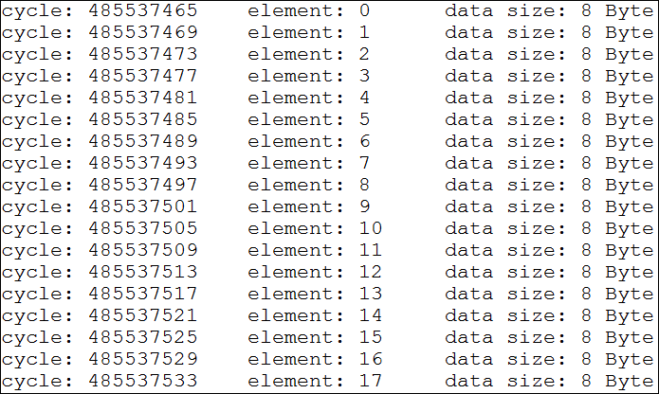
Collected Trace File – From Merlin Board
memory_trace.log

Slide 13
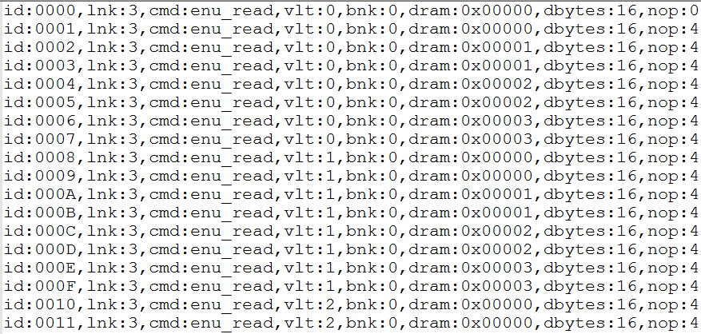
Generated Trace File – For Simulator
Determines the number of idle link cycles before this request is issued.
memory_trace_read.trc

Slide 14
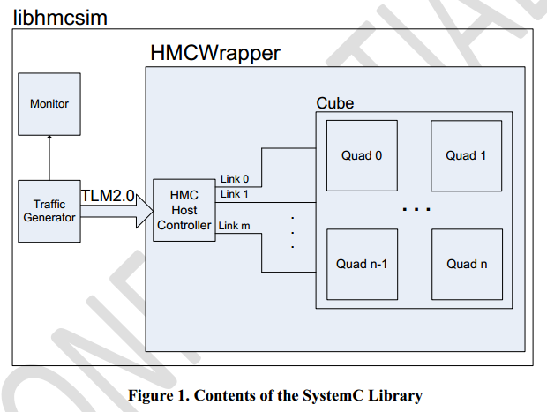
HMC SytemC Simulator - Architecture

Slide 15
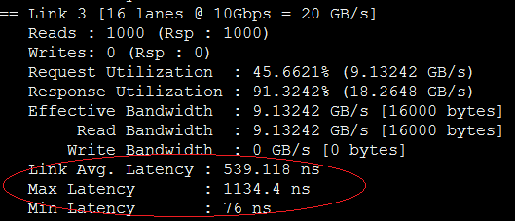
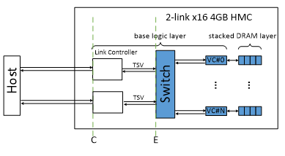
HMC SytemC Simulator - Results
HMCSim_Results

Slide 16
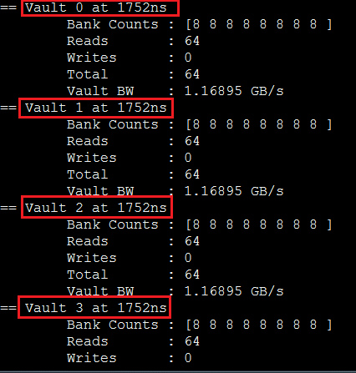
HMC SytemC Simulator - Results

